Slide 1



Navigating the Cybersecurity Landscape in Cloud Computing: Challenges, Strategies, and Future Directions
Milad Akbari
DITEN – University of Genoa
milad.akbari@edu.unige.it
Roberto Bruschi
DITEN – University of Genoa
CNIT – S2N National Lab
roberto.bruschi@unige.it
Alessandro Carrega DITEN – University of Genoa
CNIT – S2N National Lab
alessandro.carrega@unige.it

Slide 2


Agenda
Research Problem & Motivation
Cloud Computing Security Challenges
Multi-layered Security Strategies
Emerging Technologies & Solutions
Key Findings & Implications
Conclusion
Notes:
“My talk will follow six main points:
First, I’ll describe the research problem and motivation behind this work.
Then, I’ll move to security challenges in cloud computing.
I’ll introduce multi-layered strategies for tackling these challenges.
Next, I’ll highlight emerging technologies and solutions.
I’ll then present key findings from our literature review.
Finally, I’ll conclude with future directions and takeaways.
This roadmap will help us move step by step from problem to potential solutions.”

Slide 3

Research Problem & Motivation

Slide 4




Cloud Adoption
The market is expected to grow from 371.4 billion USD in 2020 to 832.1 billion USD by 2025, showing strong and sustained expansion over the period.
Widening Exposure
The widespread adoption of cloud technologies introduces new vulnerabilities, creating a broader attack surface that can be exploited if not properly secured.
Critical Gap
There is a growing need for comprehensive security strategies in cloud environments to effectively protect data, applications, and infrastructure from evolving threats.
Research Objective
Navigating the Cloud Cybersecurity Landscape: Providing a Thorough Understanding of Challenges, Strategies, and Future Perspectives.
Notes:
“Cloud computing has become a critical backbone of modern IT infrastructures. By 2025, the global cloud market is expected to more than double compared to 2020, reaching over 832 billion US dollars.
This growth is exciting, but it also comes with increased exposure to cyber threats.
As organizations adopt public, private, hybrid, and multi-cloud systems, they face a broader attack surface. Traditional perimeter-based security models no longer suffice.
Our objective in this research is to navigate this evolving cybersecurity landscape: to map out the challenges, evaluate current strategies, and highlight future directions for securing cloud environments.
In short: cloud computing is growing fast, but security is struggling to keep pace — and that’s the critical gap we want to address.”

Slide 5



Cloud Computing Models and Security
Service Models
Software as a Service (SaaS): Application-level security.
Platform as a Service (PaaS): Platform & application security.
Infrastructure as a Service (IaaS): Full stack security responsibility.
Deployment Models
Public Cloud: Shared infrastructure, higher risk exposure.
Private Cloud: Dedicated resources, controlled environment.
Hybrid Cloud: Mixed approach, complex security management.
Community Cloud: Shared among organizations with similar requirements.
Notes:
“Security in the cloud is closely tied to the service model in use.
With Software as a Service, security responsibilities lie mostly with the provider, focusing on applications and data access.
In Platform as a Service, security extends to both applications and platforms.
With Infrastructure as a Service, the responsibility shifts heavily to the customer, covering the full stack.
The deployment model also matters:
Public clouds are cost-effective but expose data to higher risks.
Private clouds offer more control but can be costly and rigid.
Hybrid clouds try to balance both, but complexity increases significantly.
And community clouds share resources among organizations with similar needs, requiring aligned policies.
This layered variety in models makes cloud security a moving target — it is not one-size-fits-all.”

Slide 6

Cloud Computing Security Challenges

Slide 7




Major Security Challenges
Network Security
DDoS attacks and network vulnerabilities
Secure communication protocols
Network segmentation and monitoring
Data Security & Privacy
Unauthorized access and data breaches
Data encryption and access control
GDPR and regulatory compliance
Infrastructure Security
Virtualization vulnerabilities
Container security issues
Physical security of data centers
Application Security
Code vulnerabilities and secure development
API security and authentication
Runtime application protection
Notes:
“Now, let’s move to the main security challenges.
First Network Security
Distributed denial-of-service attacks, insecure protocols, and poor segmentation can severely disrupt cloud services. Networks need continuous monitoring and advanced defenses.
Second Data Security & Privacy
Unauthorized access and breaches are among the top concerns. Compliance with regulations such as GDPR adds further complexity. Strong encryption and access controls are vital.
Third Infrastructure Security
Virtualization and containers, while powerful, introduce new risks like hypervisor attacks or misconfigured containers. Even physical data centers require strong safeguards.
And fourth Application Security
Applications hosted in the cloud face risks such as vulnerable code, insecure APIs, and poor runtime protections. Since APIs are the backbone of cloud interconnections, their security is particularly critical.
Together, these challenges show that cloud security is not isolated — it spans over data, applications, networks, and infrastructure.”

Slide 8
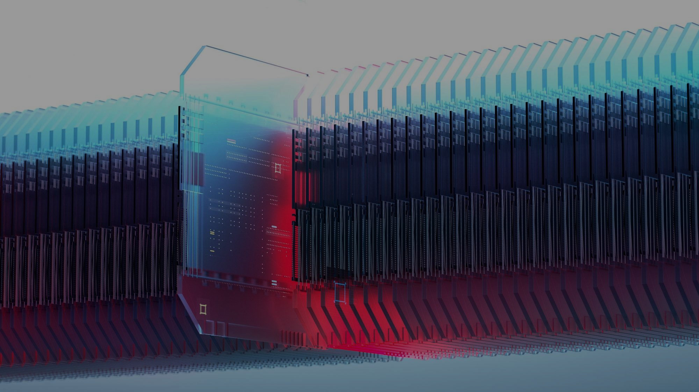
Multi-layered Security Strategies

Slide 9


Core Security Layers
Identity & Access Management
Network Security
Multi-Factor Authentication (MFA)
Role-based access control (RBAC)
Identity federation and SSO
Firewalls and intrusion detection
Virtual private networks (VPNs)
Network segmentation
Data Protection
Monitoring & Response
End-to-end encryption
Data classification and masking
Backup and recovery strategies
Continuous security monitoring
Security Information and Event Management (SIEM)
Incident response procedures
Notes:
“So how can we respond?
The answer is through multi-layered defense strategies.
For identity and access management, techniques like multi-factor authentication, role-based access, and identity federation provide strong user control.
At the data level, we need end-to-end encryption, classification, masking, and reliable backup and recovery strategies.
Network security requires firewalls, intrusion detection systems, VPNs, and segmentation.
Finally, Monitoring and response are critical. This includes continuous monitoring, SIEM tools, and well-prepared incident response procedures.
The main message is this: no single measure can secure the cloud. Only a layered, integrated approach can provide resilience against complex threats.”

Slide 10

Emerging Technologies & Solutions

Slide 11











Emerging Technologies & AI Integration
01
Zero Trust Architecture (ZTA)
"Never trust, always verify" principle
Continuous verification and validation
Micro-segmentation strategies
02
AI and Machine Learning
Behavioral pattern analysis
Anomaly detection systems
Predictive threat intelligence
Automated response mechanisms
03
Advanced Security Frameworks
NIST Cybersecurity Framework
ISO/IEC 27017:2015 standards
Cloud Security Alliance (CSA) guidelines
Notes:
“Security is not only about fixing current issues — it’s also about preparing for the next wave of threats.
Here, emerging technologies play a central role:
Zero Trust Architecture:
Which is perhaps one of the most promising paradigms. Instead of assuming trust within a network, Zero Trust enforces the principle of never trust, always verify. Continuous verification and micro-segmentation significantly reduce attack opportunities.
Artificial Intelligence and Machine Learning:
They can analyze user behavior, detect anomalies in real time, and even predict attacks before they happen. Automated response systems powered by AI can act faster than humans.
Advanced Security Frameworks:
These Frameworks like NIST, ISO/IEC standards, and Cloud Security Alliance guidelines help standardize practices and provide structured approaches.
These solutions represent a shift toward proactive and adaptive security, rather than reactive measures.”

Slide 12

Key Findings & Implications

Slide 13




Literature Review
[35]
[32]
Cyber security techniques in cloud environment: comparative analysis of public, private and hybrid cloud, M. Lata et al. 2025.
A novel framework to identify cybersecurity challenges and opportunities for organizational digital transformation in the cloud, X. Liang et al. 2025.
[34]
[33]
Literature Review of Machine Learning and Threat Intelligence in Cloud Security, R. Thaqi et al. 2025.
Secure Resource Management in Cloud Computing: Challenges, Strategies and Meta-Analysis, D. Saxena et al. 2025.
Notes:
“Now, let’s look at the key findings from recent literature, which we reviewed to map out the state of the art in cloud cybersecurity. I will briefly highlight four representative studies.

Slide 14




Literature Review
[32]
Focus: Cloud deployment models and security implications
Scope: Deployment-level threats across public, private, and hybrid clouds
Methodology: Comparative analysis of deployment models and their vulnerabilities
Key security challenges: Insecure APIs, network exposure, visibility, user-side responsibilities
Proposed strategies: Shared responsibility model, evolving frameworks, best practices
Discussed technologies: Edge computing, IoT, AI/ML, 5G
Contribution: Overview of threat landscape by deployment model; emphasizes user responsibility
Notes:
First, the article written by Liang and others published in 2025 [32].
This work focused on cloud deployment models — public, private, and hybrid — and the corresponding security implications.
Their comparative analysis showed that each model carries distinct risks.
Public clouds, for example, suffer from insecure APIs, network exposure, and limited visibility for users.
Hybrid clouds offer flexibility, but increase complexity and management challenges.
Private clouds provide better control but require more resources.
The authors emphasize the importance of the shared responsibility model, where both providers and users must implement security measures. They also discuss how emerging technologies such as IoT, edge computing, artificial intelligence, and 5G further complicate the security landscape.
Their main contribution is providing a clear overview of threats by deployment model, stressing that user responsibility is often underestimated.

Slide 15

Literature Review
[33]
Focus: SRM in virtualized environments
Scope: VM co-residency, resource allocation, and performance-security balance
Methodology: Categorization of SRM strategies (defensive, mitigating, hybrid) plus experimental evaluation
Key security challenges: VM misconfigurations, multi-tenancy risks, performance-security tradeoffs
Proposed strategies: Hybrid strategies for effective SRM
Discussed technologies: Virtualization, VM isolation, resource Scheduling
Contribution: Emphasizes need for balance in SRM; introduces taxonomy of strategies
Notes:
Second, the article written by Saxena and others published in 2025 [33].
This study examined secure resource management in virtualized environments, particularly challenges in multi-tenant systems.
They identified issues like VM misconfigurations, co-residency risks, and trade-offs between performance and security.
Their taxonomy classifies strategies into defensive, mitigating, and hybrid approaches.
Importantly, they argue that purely defensive or purely mitigating approaches are insufficient — instead, hybrid strategies strike the best balance between performance efficiency and security assurance.
Their contribution lies in introducing a structured taxonomy of secure resource management strategies and highlighting the constant tension between maximizing performance while maintaining strong security in virtualization.

Slide 16
Literature Review
[34]
Focus: ML and CTI for proactive cloud security
Scope: Intelligent threat detection and response using ML and CTI
Methodology: Review of ML-based cloud security techniques with experimental results
Key security challenges: Evolving threats, anomaly detection, real-time adaptability
Proposed strategies: Real-time adaptive ML models, integration with CTI
Discussed technologies: Supervised/unsupervised ML, IDS, CTI platforms
Contribution: Advocates integration of CTI and ML; highlights implementation gaps
Notes:
Third, the article written by Thaqi and others published in 2025 [34].
This paper explored how machine learning and cyber threat intelligence (CTI) can be integrated to strengthen cloud security.
The authors reviewed Machine Learning-based security techniques and experimental results for real-time anomaly detection.
They showed how supervised and unsupervised Machine Learning methods can enhance intrusion detection systems.
More importantly, they advocate combining Machine Learning with cyber threat intelligence platforms to achieve adaptive and proactive defenses.
The key challenge here is implementation: while Machine Learning shows great potential, models must adapt in real time to evolving threats — something still under active research.
Their contribution is highlighting the integration of cyber threat intelligence and Machine Learning as the next step for proactive cloud defense.

Slide 17
Literature Review
[35]
Focus: Trust, frameworks, and emerging technologies in cloud security
Scope: Comprehensive review using DSR framework
Methodology: Systematic review of 1,324 papers with DSR categorization
Key security challenges: Data breaches, trust management, advanced persistent threats
Proposed strategies: Research framework, integration of AI/ML, use of blockchain and ZTA
Discussed technologies: Blockchain, Zero Trust Architecture, AI/ML, Multi-cloud
Contribution: Offers high-level synthesis and future research agenda; focuses on trust and adaptability
Notes:
Finally, the article written by Lata and others published in 2025 [35].
This is a systematic review of over 1,300 papers, analyzed through the Design Science Research framework.
Their review provides a high-level synthesis of trust, frameworks, and technologies for cloud security.
They highlight persistent challenges such as data breaches, trust management, and advanced persistent threats.
The study emphasizes the importance of emerging technologies such as blockchain, Zero Trust Architecture, Artificial Intelligence, and multi-cloud deployments.
Their contribution is not just mapping current solutions, but also setting a future research agenda. They stress adaptability, trust, and resilience as key areas where innovation is urgently needed.

Slide 18

Conclusion

Slide 19



Future Research Directions
Emerging Technologies
Quantum computing impact on encryption
Edge computing security challenges
5G network integration security
Advanced Threat Detection
AI-powered threat hunting
Behavioral analytics enhancement
Real-time threat intelligence
Regulatory & Compliance
Cross-border data protection
Industry-specific security standards
Automated compliance monitoring
Notes:
Looking ahead, there are several important research directions that stand out from our analysis.
First, the role of emerging technologies.
Quantum computing, while promising, poses a serious risk to current cryptographic methods. Preparing for post-quantum encryption will be essential.
Edge computing also raises new challenges, since it distributes data and processing across many nodes that may not always be secure. Similarly, with the rollout of 5G networks, ensuring secure integration with cloud infrastructures is an urgent priority.
Second, advanced threat detection.
We see great potential in AI-powered threat hunting and enhanced behavioral analytics. Instead of waiting for an attack to occur, AI systems can proactively scan for suspicious behavior and adapt in real time. In addition, integrating real-time threat intelligence into security platforms can help organizations anticipate and block attacks before damage is done.
Third, regulatory and compliance challenges.
As data moves across borders, cross-border data protection becomes more complex. Industry-specific standards, such as those in healthcare or finance, require tailored approaches. Finally, automated compliance monitoring can help organizations keep up with increasingly strict regulations without excessive overhead.
In short, the future of cloud security research lies in developing proactive, adaptive, and technology-aware solutions that balance innovation with compliance.”

Slide 20


Conclusions & Call to Action
Key Takeaways
Cloud security requires multi-layered approach
Shared responsibility model is fundamental
Emerging technologies offer promising solutions
Human factor remains critical vulnerability
Continuous research and adaptation necessary
Call to Action
Encourage collaboration between academia and industry
Promote standardization of security practices
Advocate for increased research funding
Notes:
“Let me now wrap up with the conclusions and key takeaways of this work.
First, cloud security requires a multi-layered approach. No single tool or solution can provide full protection.
Second, the shared responsibility model remains fundamental. Providers and customers both play vital roles.
Third, emerging technologies such as AI, blockchain, and Zero Trust offer promising solutions — but they must be carefully integrated.
Fourth, we cannot forget the human factor. End-users and administrators remain a critical vulnerability if security practices are not followed.
And last but not least is the need of Continuous research and adaptation.
From these conclusions, we draw a call to action:
We must encourage collaboration between academia and industry, since effective cloud security requires combined expertise.
We should promote standardization of best practices, ensuring consistency across industries and providers.
And finally, we need to advocate for increased research funding, especially for high-risk areas such as post-quantum security and AI-powered defenses.
The cybersecurity landscape is evolving rapidly, and only through continuous adaptation, collaboration, and innovation can we ensure secure and sustainable cloud computing.”

Slide 21


Thank you
Alessandro Carrega

